Slide 1
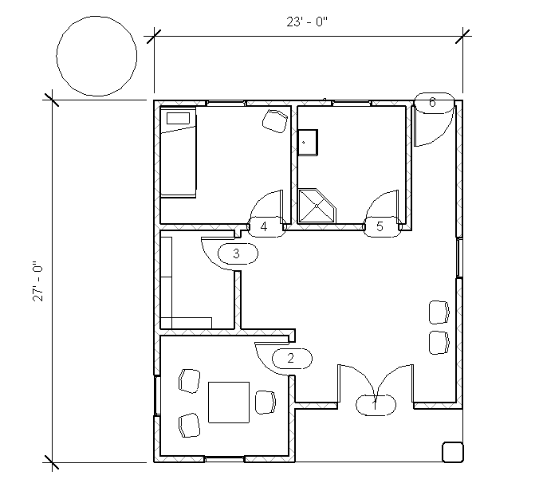
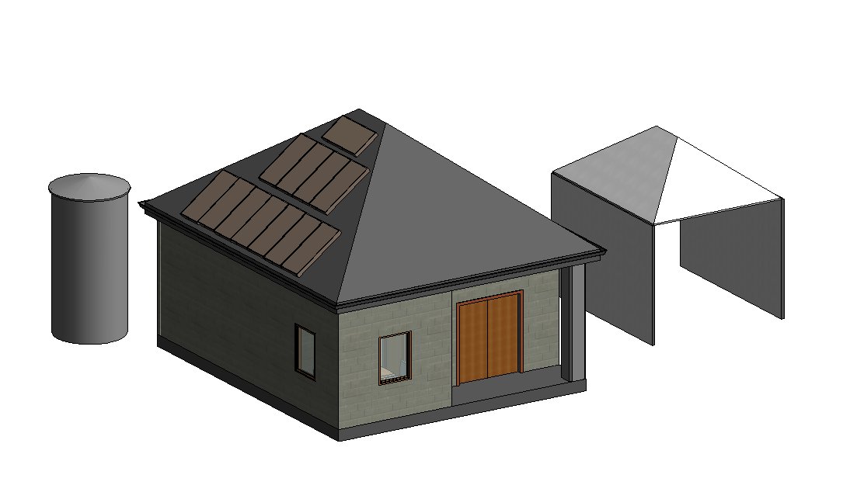
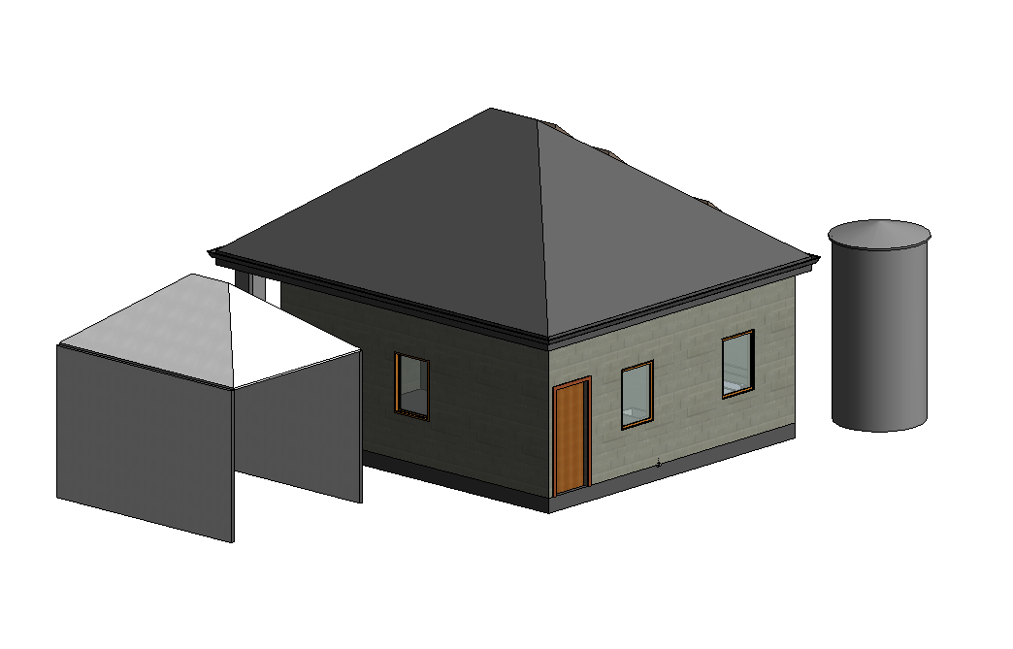
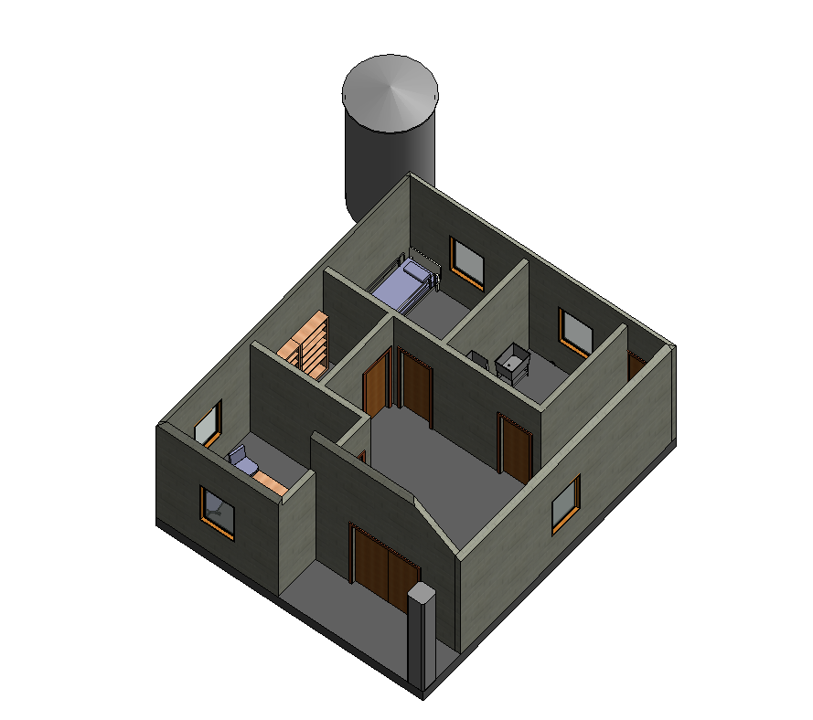
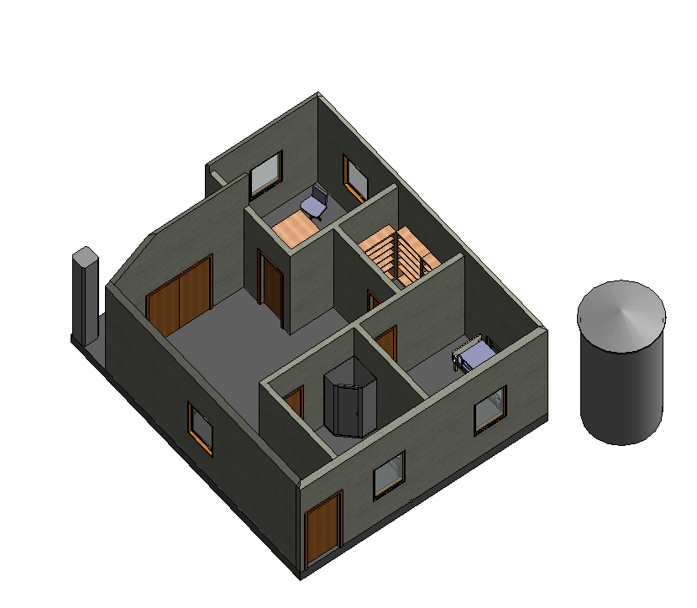
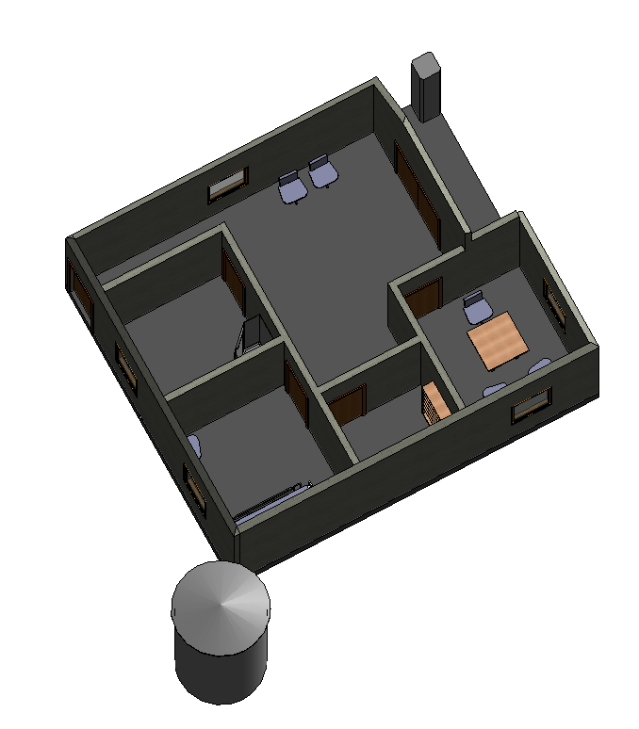
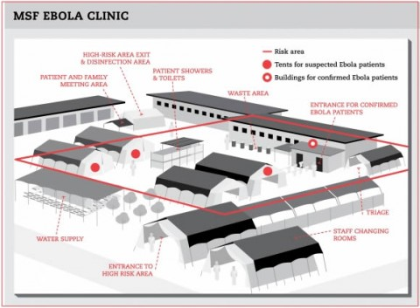
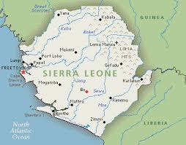
Ebola Crisis: Primary Care Center Sierra Leone
Team Members: Ryan Shirk , Parke Martin, Zachary Karasek
Introduction
Water Usage
Assumptions
Electrical Usage
West Africa is currently battling a rapid spreading disease called EBOLA. This project proposes a design plan for Primary Medical Clinics in the area. These clinics must be designed for 50 locations throughout the country. All patients will be screened for EBOLA in a triage tent outside the facility and then either directed to our facility or to a nearby emergency EBOLA treatment center.
Clean Water:
-clean water provided by Engineers without Borders
Hot Water:
- system of water barrels that are either painted or colored black.
- placed on the side of the building that receive the most amount of sun( depending on where the building is located)
- This will draw heat in from the sun throughout the day and with the help of a small water pump will allow for hot water access through the day.
3kW of energy from solar panels
Seismic and wind loads are minimal
All materials need to be handled by hand
Site locations and improvements will be determined by others
Concrete is available
Mud-brick construction
Limited stone and ceramic
Minimal steel products(e.g. nails)
Wood available
Because we were only given a 3kW photovoltaic system, we needed to minimize electrical use.
220V 50Hz Water Pump
Small Fridge
5 100W light bulbs
5 Outlets (Laptop/Phone Charger, Fan, etc).
Sierra Leone
Design
Population: 5.743 Million
: Urban Pop. 39.2%
Climate: tropical, hot, humid,
: summer rainy season(may to December)
: winter dry season (December to April)
Topography: coastal belt of mangrove swamps
: wooded hill country
: upland plateau
: mountains in the east
- high point: 1948m
- low point : 0m
Structure built using available materials (assumptions)
Soffits all the way around to increase shade
Furnished with basic furniture that can be found in the region
Double-hung windows for easy opening (air flow)
Small shower and wash basin for sterilization
Hazardous waste sent out drain in sterilization room into incinerator
Roof vented at soffit and peak for air flow
Mud-brick made on site to avoid breaking
Thatching applied to roof to decrease sun absorption
.
The Department of Engineering and Physics Elizabethtown College 2014

